Slide 1
A Brief History of Life
How Did Everything Begin?

Slide 2
Intelligent Design Theories (Creation Myths)

Slide 3
More Stories from Around the World…

Slide 4
…on how the world began…

Slide 5
…all of them unique

Slide 6
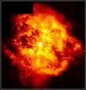

Slide 7
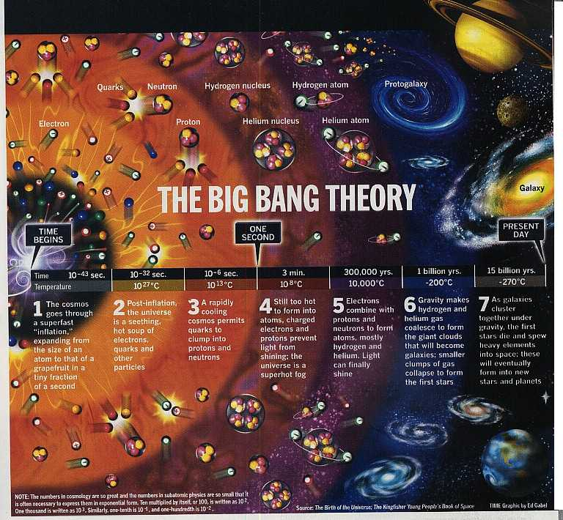

Slide 8
If the earth has existed for 4.5 billion years, what about life on earth?
Earliest evidence: cyanobacteria called stromatolites (3.4 billion years), in Australia
As early as 3.8 billion years ago
Earth was stable enough to support life
Ribonucleic Acid (RNA)

Slide 9
But where?
Possibly the ocean, based on evidences
Fossils
Deep sea microbes
Smoker fossils in China

Slide 10
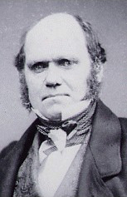
From single-celled organisms to complex creatures…
Evolution
Natural selection- helpful traits vs. harmful traits
Adaptation- best suited for environment
Genetic drift- independent process that produces random changes; chance
Diversification in nature

Slide 11
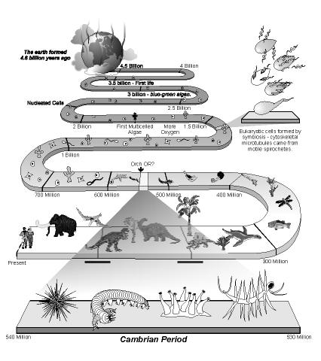

Slide 12
Cambrian Explosion

Slide 13
The Descent of Man and the Attacks on Evolution

Slide 14
The Human Story
Cenozoic Era (“Age of Mammals”)
Around 2.5 million years ago
African Savanna
Mammals including primates
Humans and chimpanzees share a common ancestor between 7 to 6 million years ago

Slide 15
If they are happy swinging in trees, why come down?
Evidences found in the Great Rift Valley, savannas on the Eastern part of Africa
Difficulty in knuckle walking → adapt to bipedalism
Predators abound → flight or fight, shelter and protect
Scattered plants → change in diet, enriched food selection

Slide 16
“The Southern Ape”
Australopithecus
5 to 1 million years ago
Characteristics similar to humans and apes
Comparable brain size with a chimpanzee
A. afarensis →

Slide 17
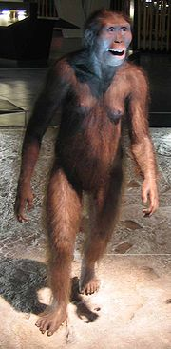
Pero murampa na ni siya…
Bipedal; hands like humans
A. africanus
Lucy in the Sky with Diamonds

Slide 18
Mr. Handy Man
Homo habilis
2.5 to 1.5 million years ago
opposable thumbs- efficient means of handling things and creating tools

Slide 19
The Original Laagan
Homo erectus
1.6 million years to 200,000 years ago
Bigger brains, taller
← Peking Man

Slide 20
Taller, Smarter, Wiser
Homo sapiens
Neanderthals
Cro-magnon

Slide 21
Wisest of them all?
Homo sapiens sapiens

Slide 22
This powerpoint was kindly donated to
www.worldofteaching.com
http://www.worldofteaching.com
Is home to well over a thousand powerpoints submitted by teachers. This a free site. Please visit and I hope it will help in your teaching
Notes:
22

